Slide 1

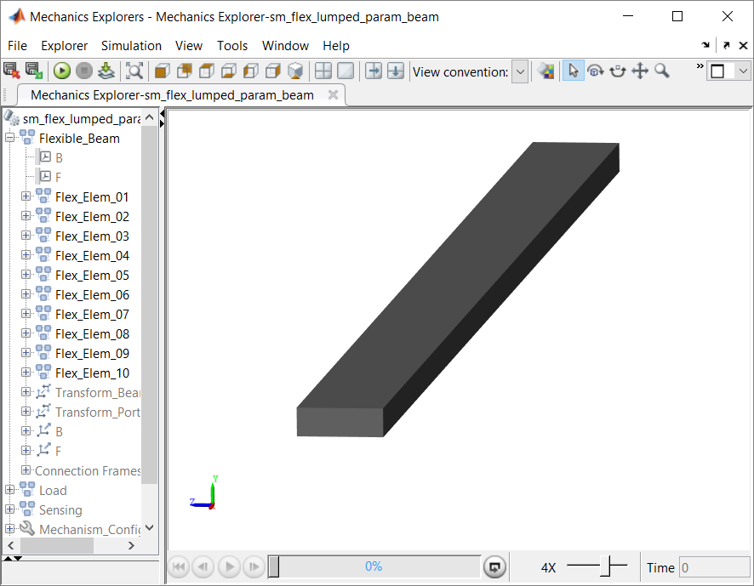
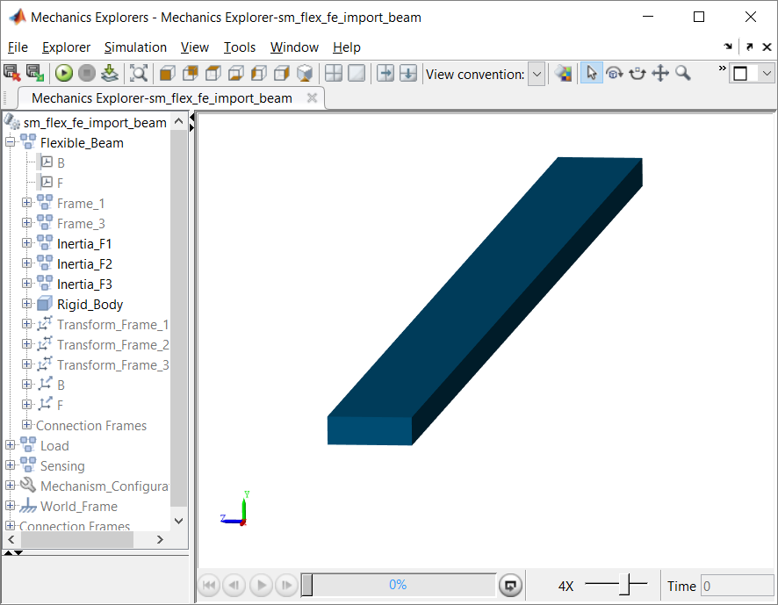
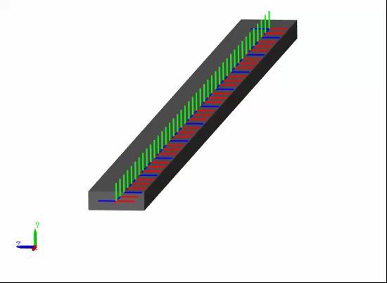
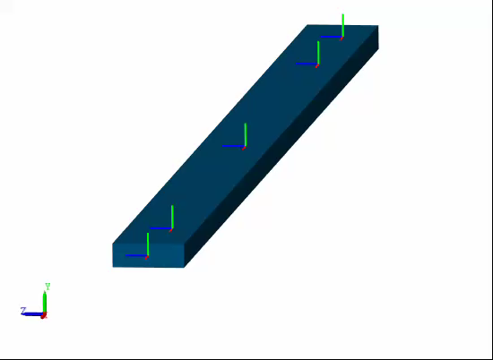
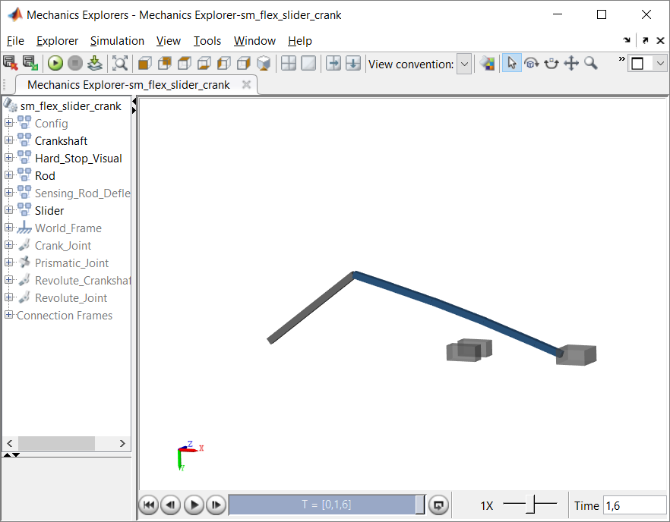
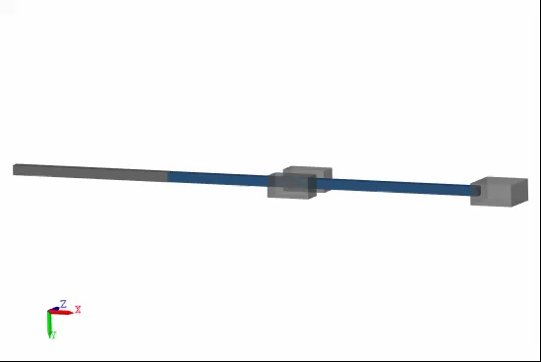
Flexible Body Examples on File Exchange
Lumped parameter beam
Chain of mass-spring-dampers
Finite element import beam
Superimpose bending onto rigid body motion
fileexchange/47051-flexible-body…

Slide 2
Flexible Bodies in Simscape Multibody Approaches
Rigid Body
Rigid Body
Rigid Body
Lumped parameter approach
Chain of rigid body-spring-dampers
No finite element software required
Only for simple geometries
Stiffness value calculation
FEA Approach
Export mass and stiffness matrices from FE software
Superimpose deflection onto rigid body motion
Valid for small deflections
Finite Element Software
STATE-SPACE SYSTEM
F1
F3
F
F
J
Motion
Motion
J
Forces
Forces
F
F
UNDEFORMED BODY
F
W
Weld Joint
F
F2

Slide 3
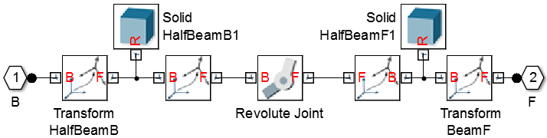
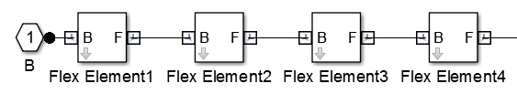
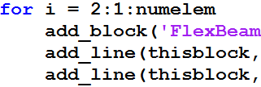
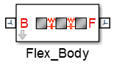
Lumped Parameter Approach Generalized Flexible Element
Element
Joint primitives reflect flexible degrees of freedom
Bend: 1 rotational
Bend+twist: 2 rotational
Bend+stretch: 1 rotational + 1 prismatic
Use MATLAB to automate construction of flexible body

Slide 4
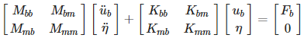
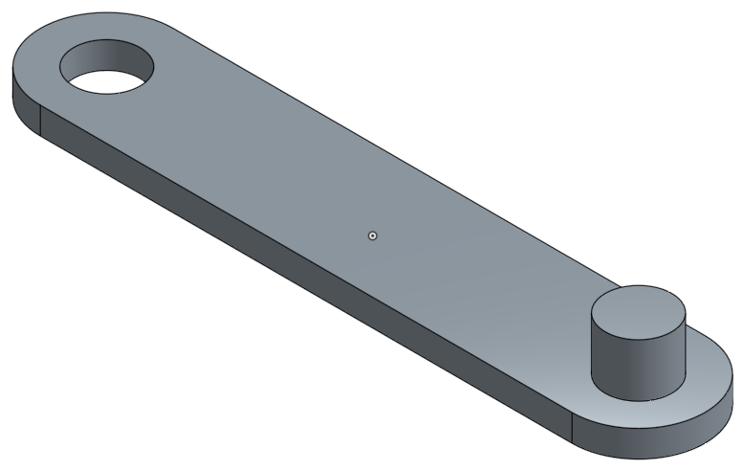
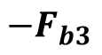
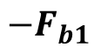
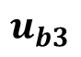
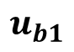
Basic Approach
Flexible-body deflection behavior modeled in Simulink is superimposed on the rigid-body motion modeled in Simscape Multibody
STATE-SPACE SYSTEM
F1
F1
F3
F
F
$$u_{b1}$$
J
Motion
Motion
$${−F}_{b1}$$
J
J
$$u_{b3}$$
Forces
Forces
$$−F_{b3}$$
F3
F
F
UNDEFORMED BODY
F2
J
F
W
Weld Joint
F
F2

Slide 5
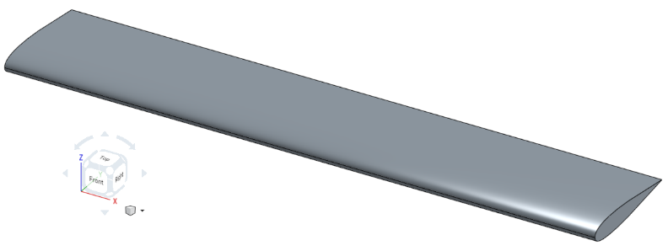
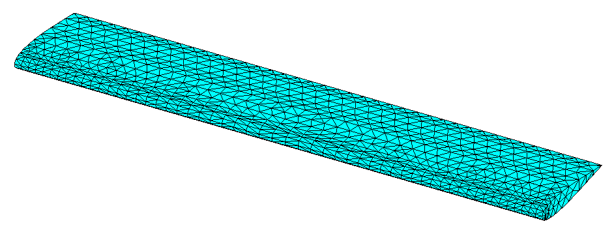
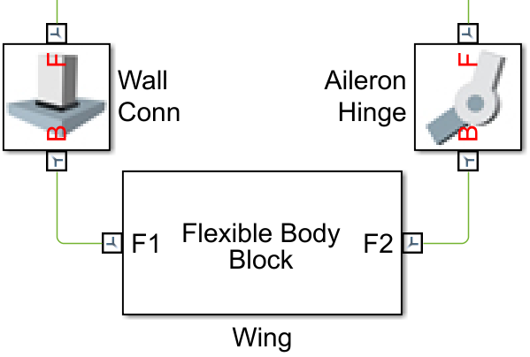
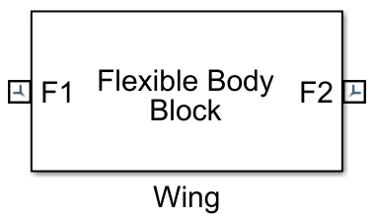

Flexible Body Modeling Workflow
CAD
Create FE model in FEA software
Define part interface
Extract reduced order model
Import data into Simscape Multibody
Connect joints, forces, etc.
Simulate
1
N1
2
FEA
N2
3
FEA
Data
5
4
6
Notes:
To model the flexibility of the wing in the context of the multibody simulation, using a Finite Element Import approach, CLICK we start with the creation of a finite element model of the wing.
CLICK Appropriate nodes are added to represent the connection points of the deformable body to other elements of the larger system.
CLICK A substructure characterizing the component’s structural behavior is generated based on the defined interface. Data for this reduced order model is stored in a file.
CLICK The data file is read to create the corresponding flexible body in the multibody system.
CLICK It is then integrated with the rest of the system, through joints, constraints, force elements, and more.
CLICK And finally, the model can be simulated and subsequently visualized and analyzed to solve the engineering problem.
CLICK

Slide 6
Building the Flexible Body Subsystem Block
Create undeformed body
Add deflection joints
Replace one joint with a weld
Add connection ports for interface frames
Add state-space flexibility model
Set actuation mode for joints
Connect state-space output to force inputs
Connect sensed motion to state-space input
Break algebraic loops with filters
Encapsulate in a subsystem
Add interface frame masses and inertias

Slide 7
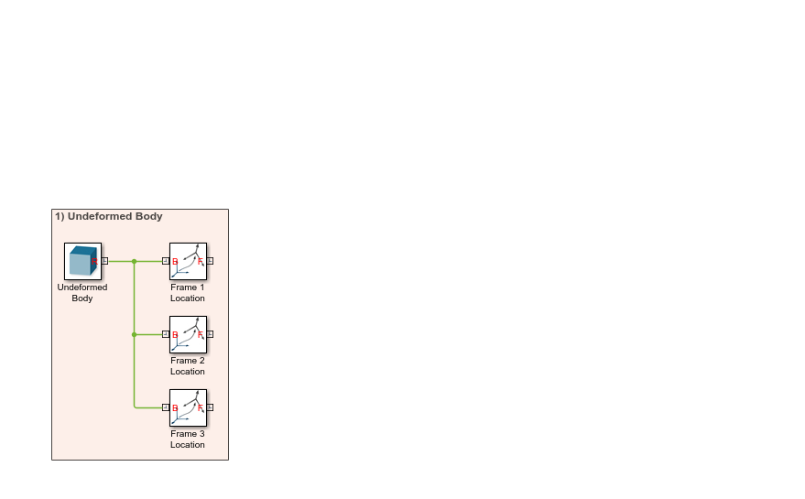
Step 1 – Create Undeformed Body
Interface frames at boundary node locations of undeformed body
F1
F2
F3

Slide 8
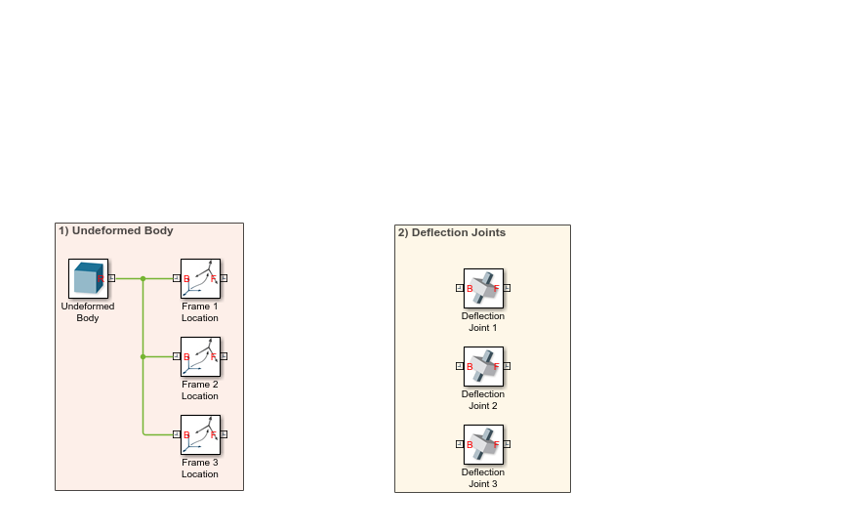
Step 2 – Add Deflection Joints
Bushing joints offer the required 6 dofs
F1
J
F2
* prismatic joints shown for simplicity
J
F3
J

Slide 9

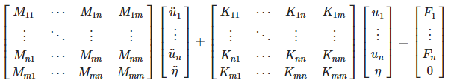
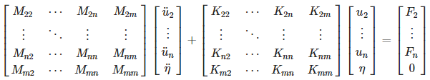
Step 3 – Replace One Joint With a Weld
Rigid-body modes in C-B model must be removed
Zero deformation at weld joint interface frame

Slide 10
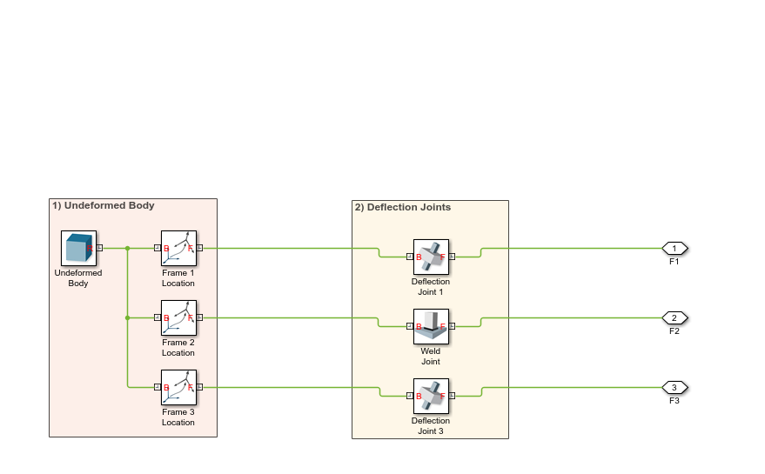
Step 4 – Add Connection Ports for Interface Frames
Expose interface frame ports on enclosing subsystem block
F1
J
F3
F2
J

Slide 11
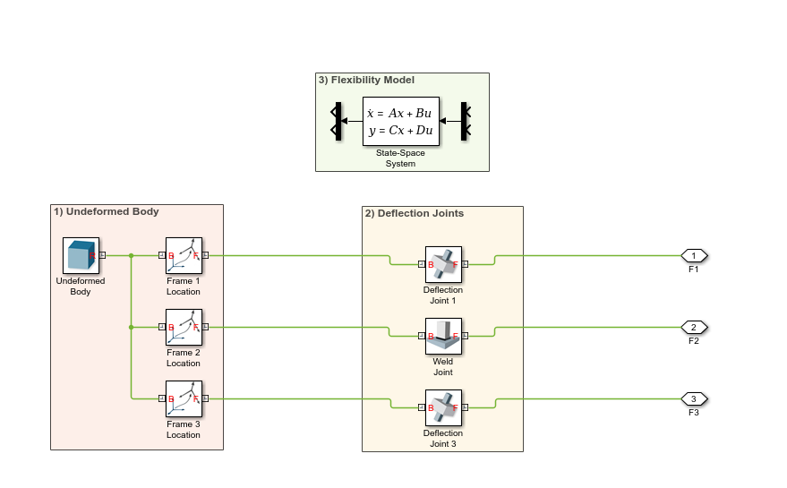
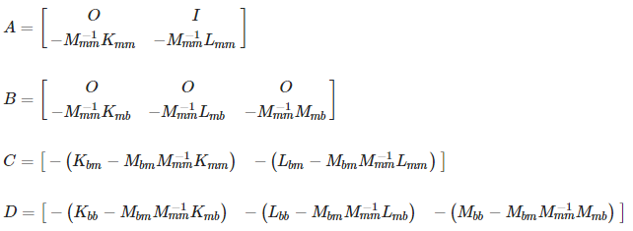
Step 5 – Add State-Space Flexibility Model
A, B, C, D matrices derived from reduced model equations

Slide 12
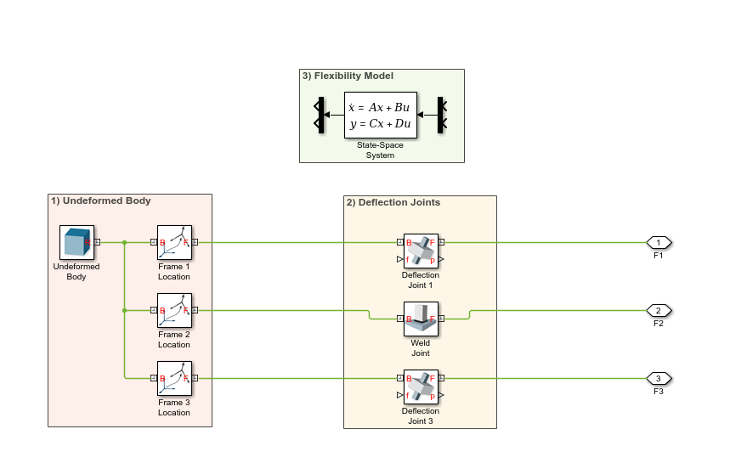
Step 6 – Set Actuation Mode for Joints
Force: Provided by Input
Motion: Automatically Computed
* only position outputs shown for simplicity

Slide 13
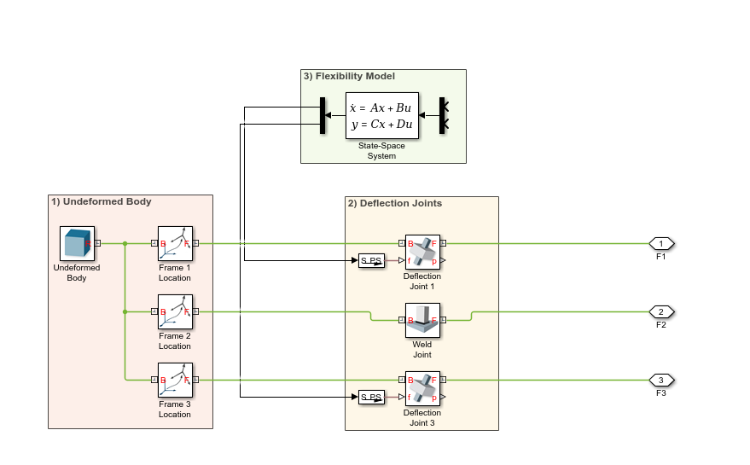
Step 7 – Connect State-Space Output to Force Inputs
State-space force outputs actuate deflection joints

Slide 14
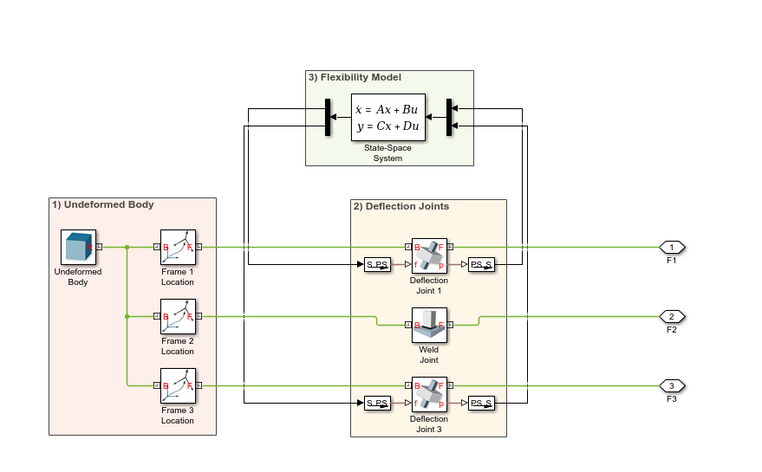
Step 8 – Connect Sensed Motion to State-Space Input
Sensed deflection joint motions used to compute appropriate forces

Slide 15
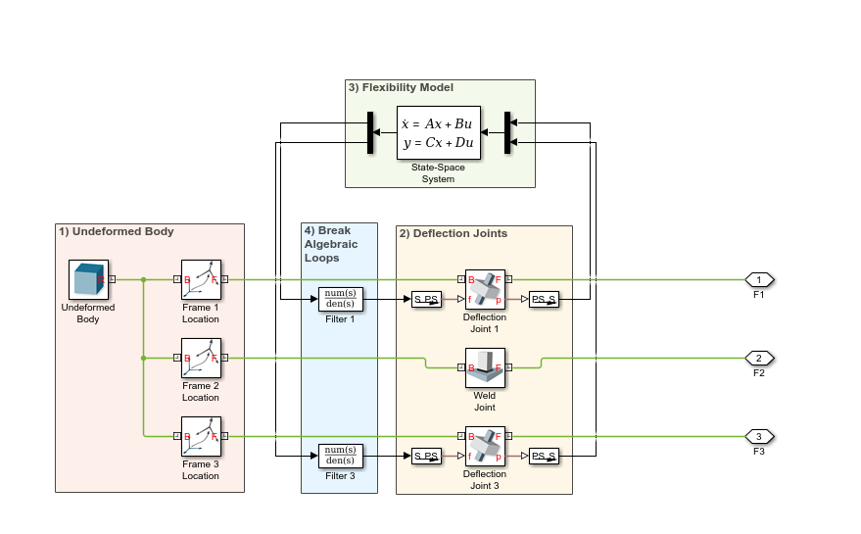
Step 9 – Break Algebraic Loops with Filters
Direct feedthrough in SS system (D matrix) and SM mechanism (accel/force)

Slide 16
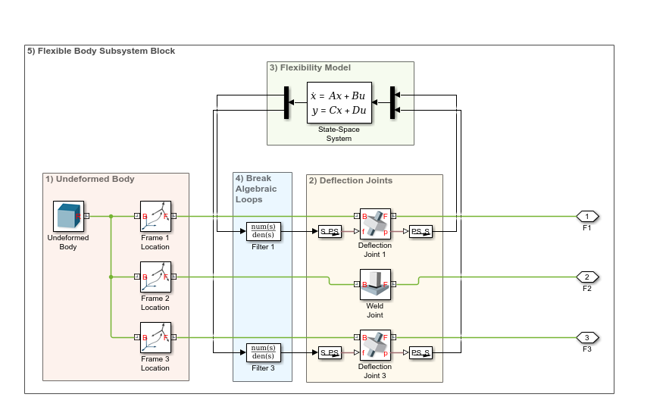
Step 10 – Encapsulate in a Subsystem
Block can be used modularly

Slide 17
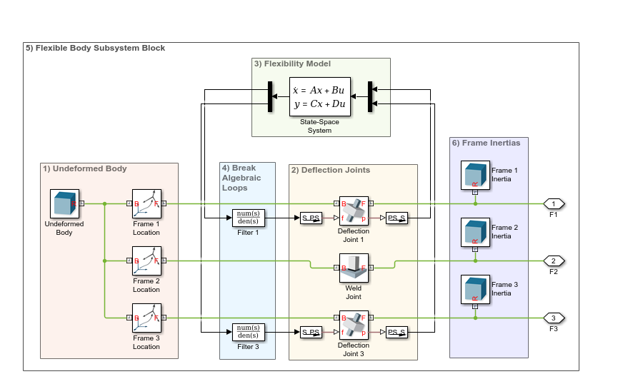
Step 11 – Add Interface Frame Masses and Inertias
Best practice: non-zero effective mass and inertia at every moving frame
Small masses and inertias can hurt numerical stability

Slide 18
High-Level Modeling Procedure for Using the Block
Choose a reference frame for the flexible body
Create CAD and FEA models
If necessary, add 6-dof nodes to the FE model
Choose the connection points for the multibody system
Generate the Craig-Bampton reduced model
Generate other required data
Add the flexible body block to the multibody system

Slide 19
Step 1 – Choose a Reference Frame for the Flexible Body
Reference frame should be consistent between the different models:
CAD model
FEA model
Multibody model
Frame with respect to which:
Coordinates of points on body are defined
Deformations are measured

Slide 20
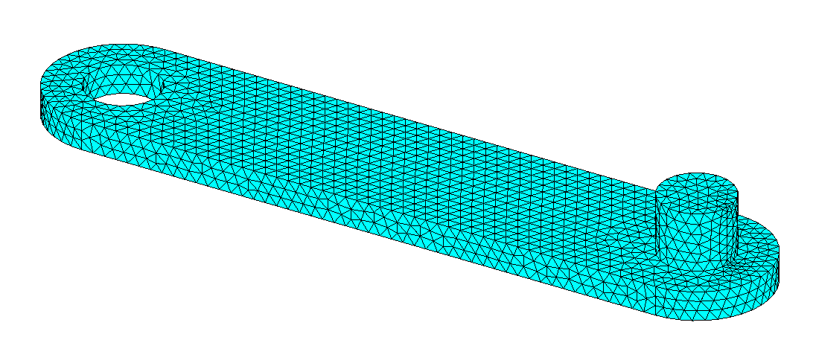
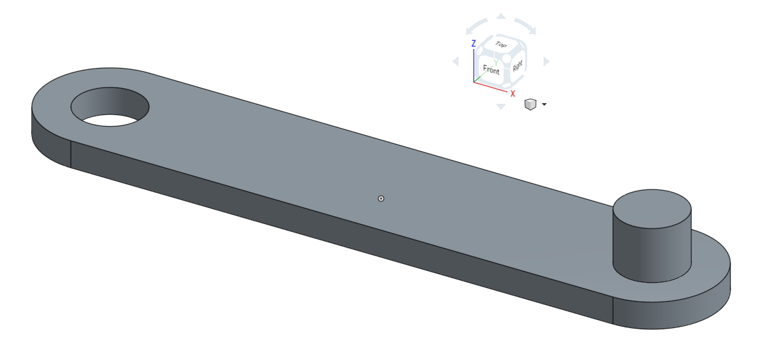
Step 2 – Create CAD and FEA Models
Reference frame consistent between various models
CAD Model
FEA Model

Slide 21
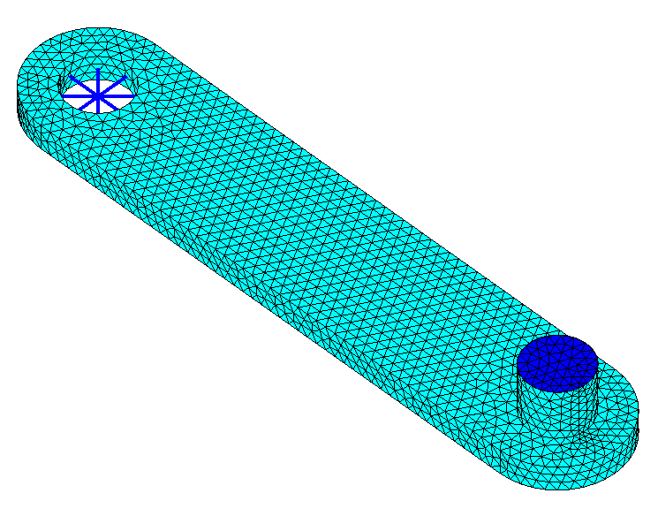
Step 3 – If Necessary, Add 6-Dof Nodes to the FE Model
For compatibility with the multibody system, the FEA substructure must have 6-dof nodes
3-D beam or shell elements
Individual 6-dof nodes, properly constrained to other nodes
Rigid
Region
Spider

Slide 22
Step 4 – Choose the Connection Points for the Multibody System
For attaching joints, bodies, constraints, forces, etc.
For visualization, sensing, etc.
Ordering must be consistent between all data structures
F1
F2
F3

Slide 23
Step 5 – Generate the Craig-Bampton Reduced Model
To create the substructure, select:
Nodes to retain
Number of dynamic vibration modes to include
This process generates:
Reduced mass matrix M
Reduced stiffness matrix K
Optionally, a recovery matrix (not needed for simulation)

Slide 24
Step 6 – Generate Other Required Data
Other data derived from the CAD and FEA models:
CAD file in STL or STEP format
Array of interface frame coordinates
Inertia properties of the undeformed body (mass, com, moi, poi)
Array mapping interface frame indices to dof indices in reduced dof vector
May be trivial if order matches in C-B substructure and multibody system

Slide 25
Step 7 – Add the Flexible Body Block to the Multibody System
Additional parameters may be required:
Simulation:
Filtering constant to break algebraic loops
Mass and inertia at the interface frames
Visualization:
Approximate in nature, so may need tweaking

Slide 26
Other Topics – Mass at Interface Frames
Since deflections are modeled through joints, degenerate mass errors can occur if the interface frames of the flexible body are directly connected to other joints or other elements such as constraints, forces, etc.
To address the issue
Use small negligible masses and inertias (how to pick sizes?)
Attach small but meaningful masses and inertias that represent something physical
Divide body into bigger chunks – mass and inertia are more evenly distributed

Slide 27
Other Topics – Mass at Interface Frames
Use small negligible masses and inertias
Does not correspond to any meaningfully modeled aspect of the system
Small enough to have negligible effect on the dynamics
Large enough to avoid degenerate mass errors or slowness of simulation

Slide 28
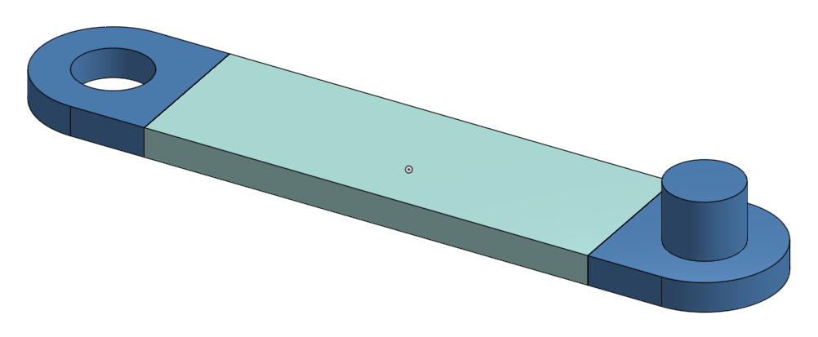
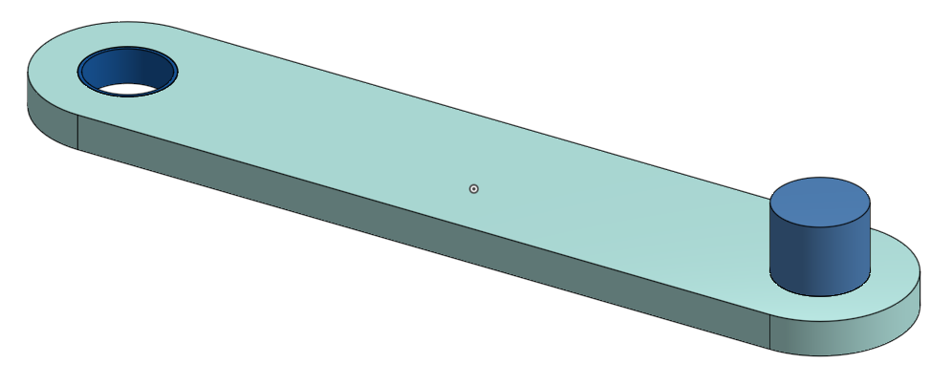
Other Topics – Mass at Interface Frames
Attach small but meaningful masses and inertias that represent something physical: collars, pins, connectors, part ends, etc.
Rigid Pieces
Rigid Pieces
Modeled as
Flexible Body
Modeled as
Flexible Body

Slide 29
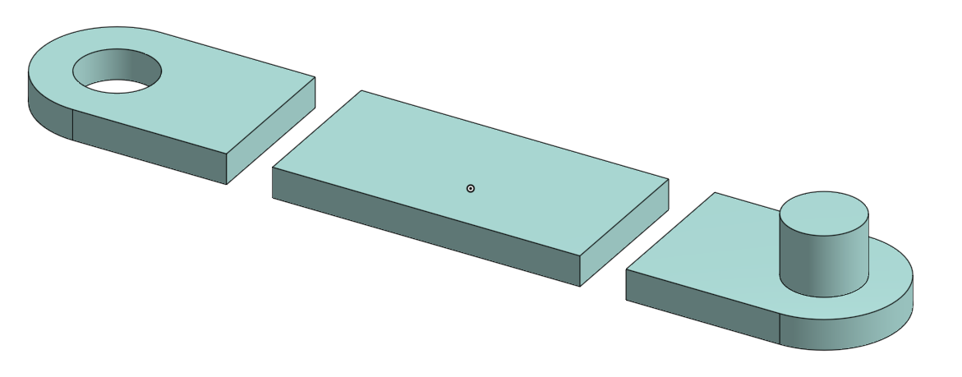
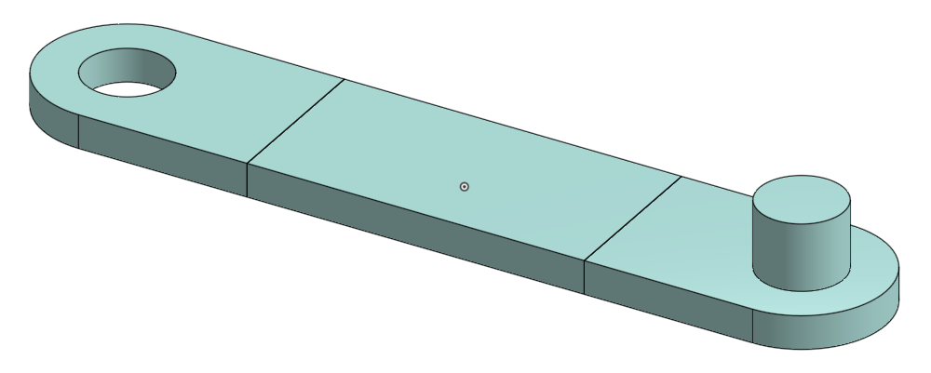
Other Topics – Mass at Interface Frames
Model the entire part as a flexible body
But divide mass and inertia into chunks (mass more evenly distributed)
Entire Body
Modeled as
Flexible Body
Rigid Body Inertia
Split Between
Interface Frames

Slide 30
Other Topics – Visualization
For larger deformations
Quality of visualization decreases (only undeformed body is shown)
Visualization can be misleading (depends on undeformed body attachment frame)

